Slide 1


WTF is Chat-GPT??
A lightning overview of NLP
Emily Lynn
OpenAI logo
Notes:
On the bench one of the things I’ve been doing is working towards a Spark NLP certification, and there’s been a lot of hype around Chat-GPT lately, so I wanted to give some insight into what NLP is in general so that if clients are asking about how to use similar kinds of technology we have an idea of what goes into this kind of work and what kind of solutions are possible.

Slide 2
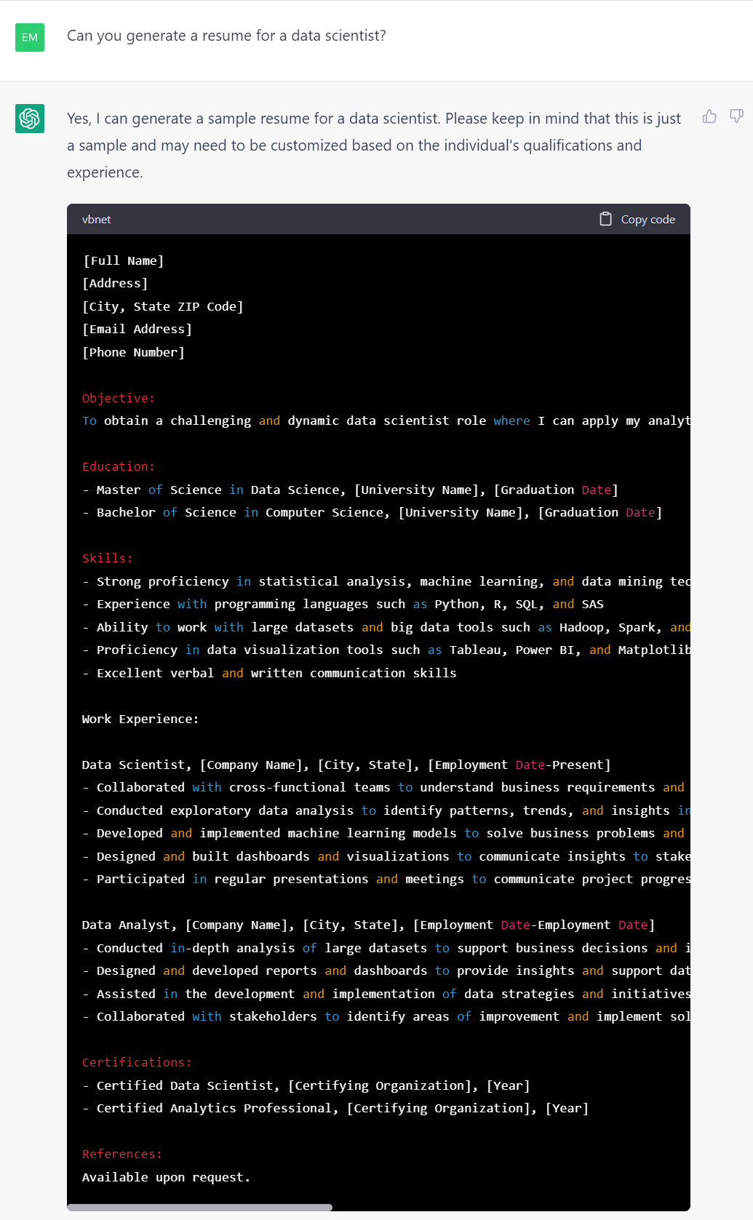
I asked Chat-GPT to generate a resume for a data scientist…
To play around with Chat-GPT yourself go to https://chat.openai.com/chat
Do it, highly recommend
Notes:
For those who don’t know, Chat-GPT is a chat bot, but not like one of those annoying chat bots that are just in the way of you talking with a real person customer service representative. It can answer questions about a wide range of topics, and even write/debug code! I recommend playing around with it some.
Here is an example, where I asked it to create a resume for a data scientist. It gave me this resume for a very qualified data scientist, with placeholders for company names and dates and everything.
There’s a lot going on here:
Must understand what I’m asking
Must know information about what skills and experience a data scientist needs
Much know the structure of a good resume
Must know how to put all of that information together in a way that makes sense in the English langauge

Slide 3
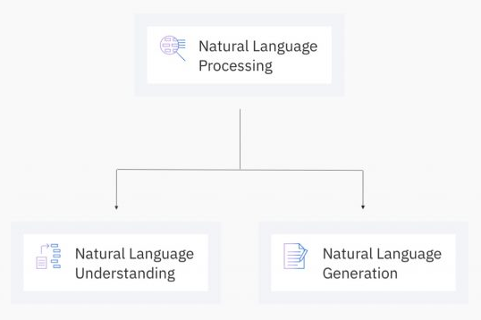
Image from NLP vs. NLU vs. NLG: the differences between three natural language processing concepts - Watson Blog (ibm.com)
Notes:
What is actually happening in the background here?
Chat-GPT is built using NLP, which is short for Natural Language Processing, which is a subset of AI. To understand this better we’re going to further break down NLP into two of its own subset, Natural language Understanding and Natural Language Generation and see some of what is involved in each of these subsets and how it all comes together to make Chat-GPT possible.

Slide 4
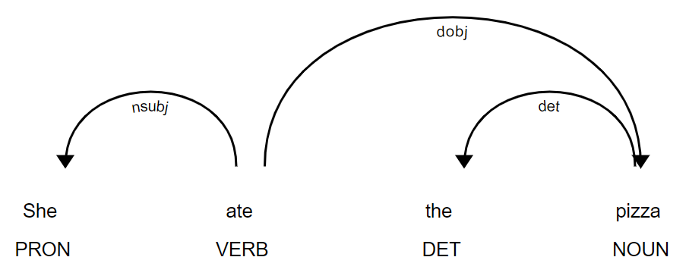
Natural Language Understanding (NLU)
The subset of NLP that focuses on the machine determining the intended meaning of a sentence or body of text. AKA the process of taking unstructured human language data, converting it into a structured data format, and interpreting it.
Tokenization and Sentence Boundary Detection
Part-of-Speech Tagging and Dependency Parsing
Named-Entity Recognition
Segment text strings into separate words and sentences.
E.g. how would a computer determine where this sentence ends? – “Today the U.K. expects 10.5 in. of snow (that’s a lot!).”
Assigning grammar types to words (like verb, adverb, noun, pronoun, etc.) and defining the relationships between words.
Detecting entities (certain types of words or phrases) in a body of text and categorizing them (e.g. person, organization, location, or something industry specific).
Context – not a fruit
Images generated with Python NLP package spaCy : https://spacy.io/
Notes:
One of those subsets is Natural Language Understanding, abbreviated NLU. This area of NLP focuses on determining what a body of text means. So its taking unstructured human language, systematically turning it into structured data, and then interpreting the meaning. There are a lot of steps that go into it, but here are some examples.
First we have to even figure out what parts of the string are words and sentences. It would need to know that there are lot’s of different usages for a period other than ending a sentence, and that contractions are actually two words, things like that.
Once we have words and sentences it then needs to figure out what parts of grammar each word is and the relationships between the words, like what is the subject that is doing this verb, that kind of thing.
Finally it needs to start assigning some meaning to those words. It needs to know that in context Apple is an organization not a fruit, or that we meant resume in our original question instead of resume.
And each of these steps is actually its own ML model doing the work.

Slide 5
Common Applications of NLU
E.g., what is this tweet about?
Sentiment Analysis
Topic Modeling
E.g., are our customer reviews positive or negative?
Smart Translation
Content Moderation
Chat Bots

Slide 6
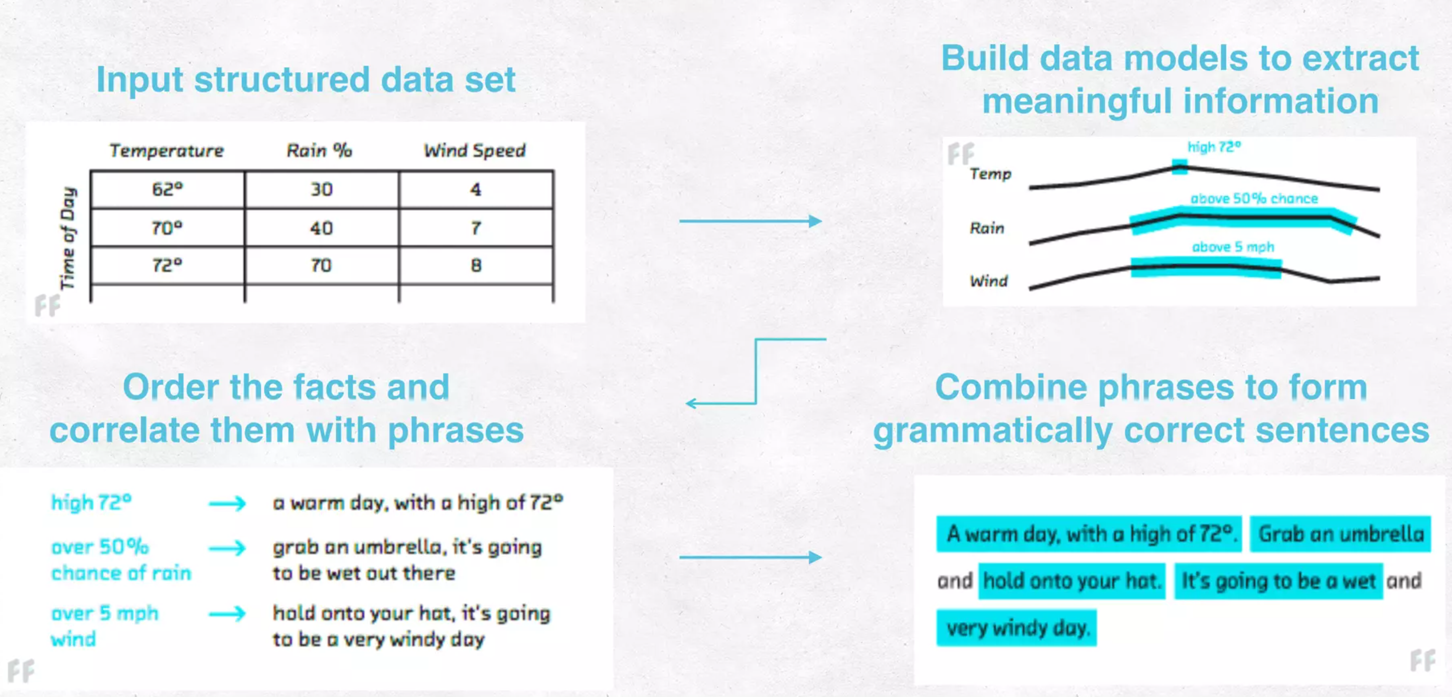
Natural Language Generation (NLG)
The subset of NLP that focuses on turning structured data back into human-readable text.
Image from https://www.slideshare.net/AutomatedInsights/natural-language-generation-new-automation-and-personalization-opportunities
Notes:
The other subset of NLP is Natural language Generation or NLG. This is like the opposite of NLU, it take structured data and turns it back into human-readable text.
For instance this could be a ML bot that generates tweets for a weather company. It looks at the structured weather data in the database, charts that data and automatically pulls outs some trends, relates those trends to phrases about the weather, and then organizes those phrases in a way that flows like human language.
So this includes figuring out the information itself, then the grammar it wants to assign to that data, and then finally the structure of the output. Just like for our original example it needed to not just know about what makes a good data scientist but also how to structure it as a resume and have it make grammatical sense.

Slide 7
Common Applications of NLG
E.g., give me single paragraph that summarizes this blog post.
Text Summarization
Description Generation
Automated Content Creation
Report Generation
E.g., generate a sports article based on the stats of last night’s game.
Chat Bots

Slide 8
To Sum it All Up…
LOTS of human training hours
NLU
+
Chat-GPT
=
+
NLG
Notes:
Our NLP equation

Slide 9
Thank You!
(Now go play with Chat-GPT)

